Slide 1
Cloud Computing

Slide 2
Cloud computing provides advantages like lower cost, faster time to market, and increased employee productivity

Slide 3
What Is Cloud Computing?
On-demand self-service
Add or subtract resources as necessary
Broad network access
Mobile, desktop, mainframe
Resource pooling
Multiple tenants share resources that can be reassigned dynamically according to need and invisibly to the tenants
Rapid elasticity
Services can quickly and automatically scale up or down to meet customer need
Measure service
Like water, gas, or telephone service, usage can be monitored for billing

Slide 4
Service Models
Software as a service (SaaS)
The cloud provider gives the customer access to applications running in the cloud
Platform as a service (PaaS)
The customer has his or her own applications, but the cloud provides the languages and tools for creating and running them
Infrastructure as a service (IaaS)
The cloud provider offers processing, storage, networks, and other computing resources that enable customers to run any kind of software

Slide 5
Service Models

Slide 6
Deployment Models
Private cloud
Infrastructure that is operated exclusively by and for the organization that owns it
Community cloud
Shared by several organizations with common needs, interests, or goals
Public cloud
Owned by a cloud service provider and offered to the general public
Hybrid cloud
Composed of two or more types of clouds, connected by technology that enables data and applications to balance loads among those clouds

Slide 7
Cloud Provider Assessment
Security issues to consider:
Authentication, authorization, and access control options
Encryption options
Audit logging capabilities
Incident response capabilities
Reliability and uptime
Resources to help with assessment:
FedRAMP - Federal Risk and Authorization Management Program
PCI DSS
CSA STAR - Cloud Security Alliance (CSA) maintains the Security, Trust & Assurance Registry (STAR)

Slide 8
Security Risks
Loss or theft of intellectual property
Compliance violations and regulatory actions
Loss of control over end user actions
Malware infections that unleash a targeted attack
Contractual breaches with customers or business partners
Diminished customer trust
Data breach requiring disclosure and notification to victims
Increased customer churn
Revenue losses

Slide 9
Switching Cloud Providers
Switching cloud providers is expensive and difficult but sometimes becomes necessary and urgent
It is best to have backup options in place in case a migration away from a cloud provider is necessary, but many cloud providers make that practically impossible
SaaS providers are generally hardest to migrate away from, followed by PaaS, then IaaS

Slide 10
Security Benefits of Cloud Services
Geographic diversity
Many cloud providers run data centers in disparate geographic locations and mirror data across locations, providing protection from natural and other local disasters.
Platform and infrastructure diversity
Different platforms and infrastructures mean different bugs and vulnerabilities, which makes a single attack or error less likely to bring a system down.
Using cloud services as part of a larger system can be a good way to diversify your technology stack.
Cloud computing mitigates the risk of single points of failure.

Slide 11
Cloud-Based Security Functions
Some security functions may be best handled by cloud service providers:
Email filtering
Since email is already hopping through a variety of SMTP servers, adding a cloud-based email filter is as simple as adding another hop.
DDoS protection
Cloud-based DDoS protection services update your DNS records to insert their servers as proxies in front of yours. They maintain sufficient bandwidth to handle the flood of attack traffic.
Network monitoring
Cloud-based solutions can help customers deal with steep hardware requirements and can provide monitoring and incident response expertise.

Slide 12
What is Virtualization?
Virtualization is the creation of a virtual resource or device where the framework divides the resource into one or more execution environments
Examples of Virtualization
Virtual drives
Virtual memory
Virtual machines
Virtual servers

Slide 13
It has been found useful in many installations to use an operating system to simulate the existence of several machines on a single physical set of hardware.
The IBM VM/370 operating system is one example.
This technique allows an installation to multiprogram several different operating systems (or different versions of the same operating system) on a single physical machine.
The dynamic-address-translation hardware allows such a simulator to be efficient enough to be used, in many cases, in production mode.
—Architecture of the IBM System/370, Communications of the ACM, January 1978, Richard Case and Adris Padegs

Slide 14
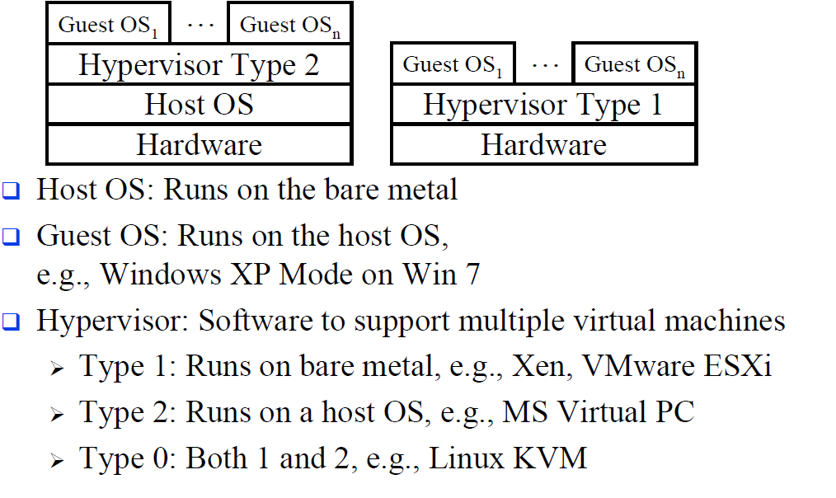
Server Virtualization

Slide 15
Desktop Virtualization
Desktop virtualization separates the software from the physical thin client device.
This enables users to access applications and data over different devices and remotely, if they cannot make it into the office.
If a device is lost or stolen, IT manager has the ability to remotely erase any company data from the device.

Slide 16
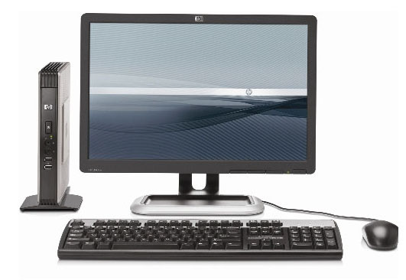
Thin Client
Also called Remote Desktop Virtualization
or Virtual Desktop Infrastructure (VDI)
or Access Virtualization
Remote server provides most of the computing and storage resources
All programs and data is stored on remote servers
Local computer is simple with limited resources

Slide 17
Desktop Virtualization Architecture
V i r t u a l
Applications
Applications
Applications
Guest OS (Windows)
Guest OS (Linux)
Guest OS (VMware ESX)
Virtual Machine
Virtual Machine
Virtual Machine
P h y s i c a l
Virtual Machine Manager
Host OS
Hardware

Slide 18
What is a hypervisor?
A hypervisor, also called a virtual machine manager (VMM), is a program that allows multiple operating systems to share a single hardware host.
Each operating system appears to have the host's processor, memory, and other resources all to itself.
However, the hypervisor is actually controlling the host processor and resources, allocating what is needed to each operating system in turn and making sure that the guest operating systems cannot disrupt each other.

Slide 19
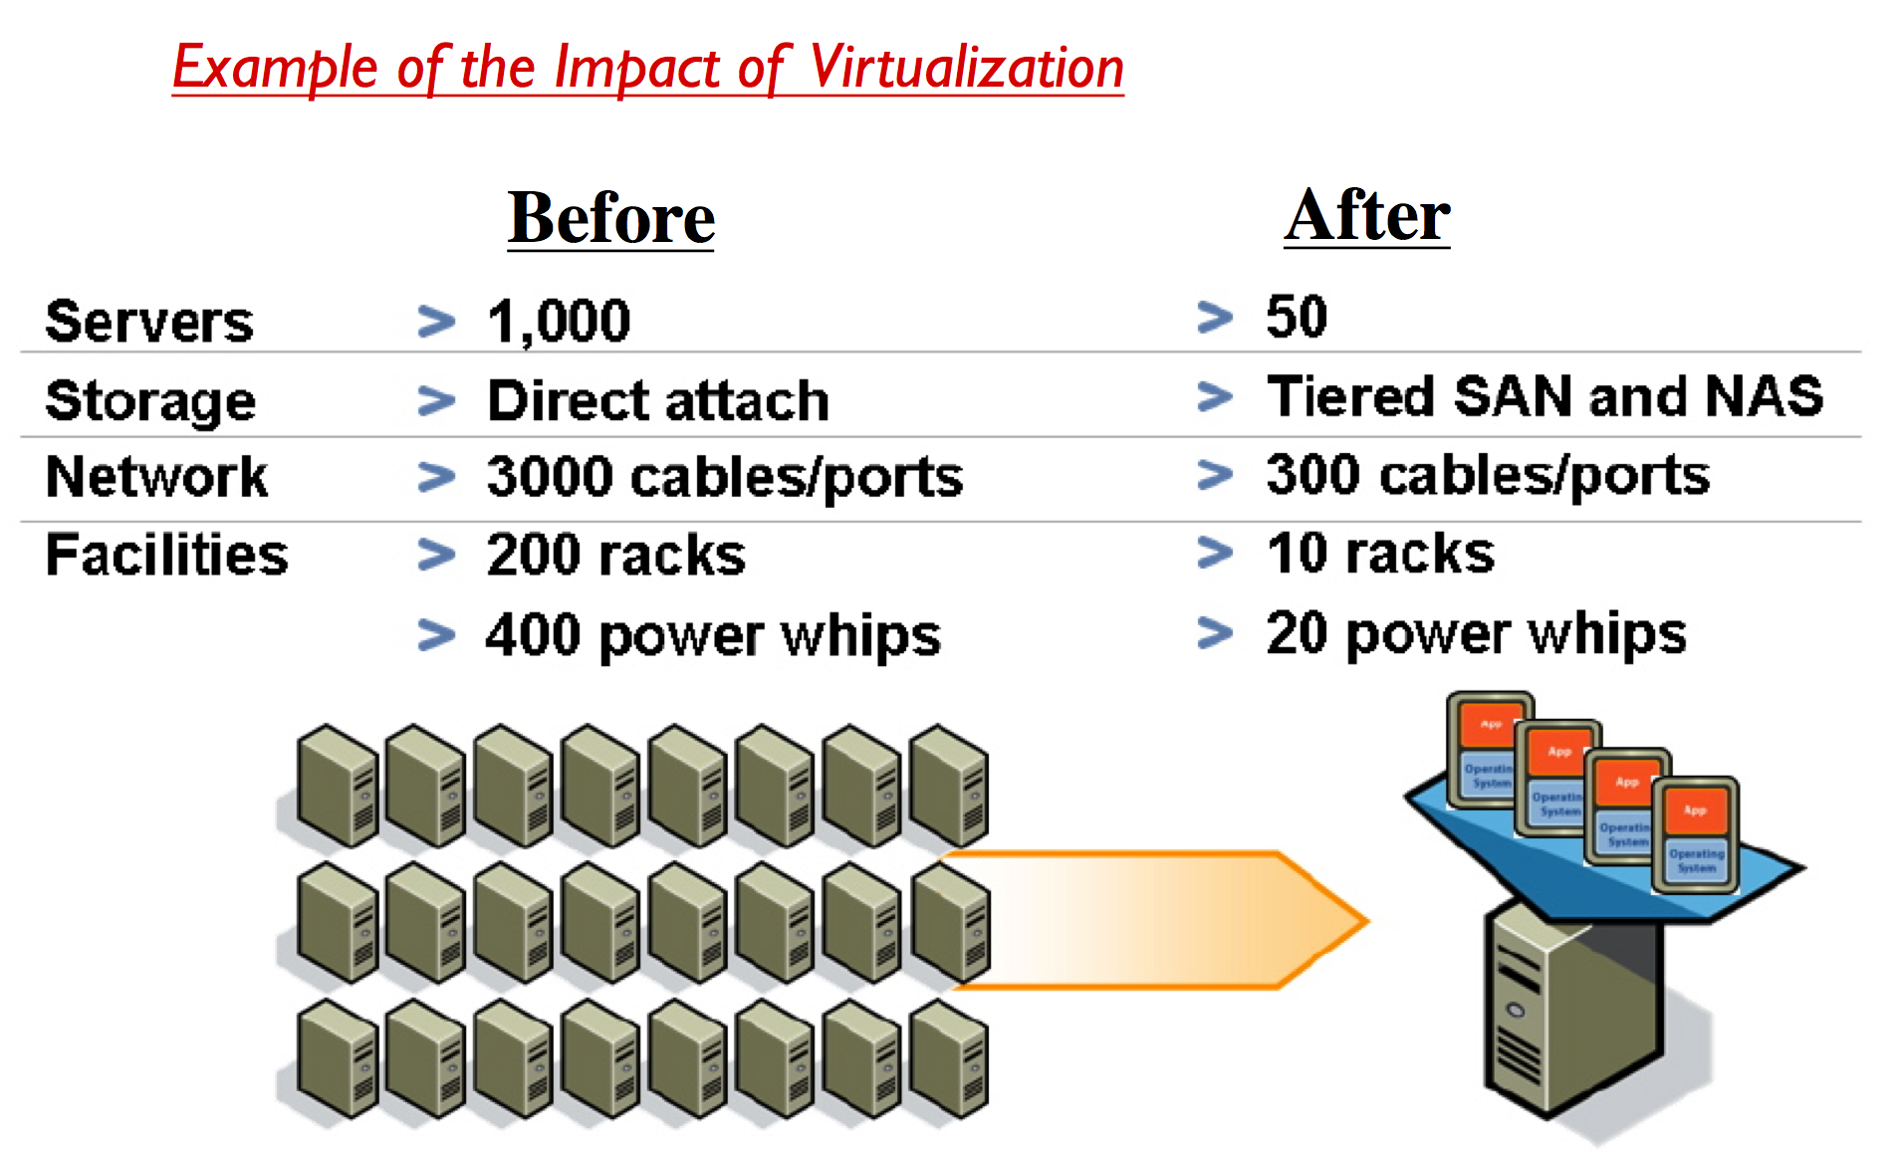

Slide 20
Other Driving Factors
There is a considerable amount of traffic among virtual servers, for purposes as maintaining consistent images of database and invoking security functions such as access control
Existing network infrastructures can respond to changing requirements for the management of traffic flows, providing differentiated QoS levels and security levels for individual flows, but the process can be very time-consuming for large networks or involves network devices from multiple vendors.

Slide 21
Cloud Service Providers in India
IBM India (Bengaluru)
Cisco Systems
Vmware
Sify
CtrlS
Orangescape
MS Azure

Slide 22
Data Protection in the Cloud
Shared storage involves a threat of access from sharing neighbours.
Changing cryptographic keys for large amounts of encrypted data is time consuming.
A protocol using master and user keys makes changing efficient in use of time.
Sharing cryptographic keys with cloud storage providers potentially exposes sensitive data.

Slide 23
Cloud Storage
By default, most cloud storage solutions either store users’ data unencrypted or encrypt all data for all customers using a single key and therefore don’t provide strong confidentiality
Some cloud services provide better confidentiality by generating keys on a per-user basis based on that user’s password or some other secret
For maximum confidentiality, some cloud providers embrace a trust no one (TNO) model in which even the provider does not have the keys to decrypt user data

Slide 24
Data Loss Prevention (DLP)
DLP is more difficult in cloud environments than on-premise environments, as cloud customers have much less control over data ingress and egress points
DLP options for cloud-based corporate data:
Force users to work through the corporate virtual private network (VPN) to access corporate-contracted cloud resources
Install DLP agents on users’ corporate systems
In IaaS environments, insert a DLP server as a proxy between user systems and other corporate cloud servers

Slide 25
Cloud Application Security
Attacks against shared resources
Sharing a system with a vulnerable application may result in those shared resources becoming compromised and consequently spreading attacks to your applications.
There are also attacks, such as cryptographic side-channel attacks, that specifically target shared resource environments.
Attacks against insecure APIs
Cloud vendors have a history of using known broken APIs.
Several security incidents have been found to be caused by insecure interfaces and APIs.
A separate study found major security weaknesses in SSL libraries used by major cloud service providers, including Amazon and PayPal.²

Slide 26
Federated Identity Management (FIdM)

Slide 27
Security Models
Security Requirements
Security Models
Confidentiality
Integrity
Availability
Bell-LaPadula Model (1973)
Biba Model (1977)
Clark-Wilson Model (1987)
Access Control Matrix
Information Flow Model
Noninterference Model
Chinese Wall Model
Lattice Model

Slide 28
Bell-LaPadula Confidentiality Model
Hierarchical state machine model
Three fundamental modes
Secure state
Defines access rules

Slide 29
Bell-LaPadula Model
Funded by the U.S. government, Bell-LaPadula model is the first mathematical model of a multilevel security policy.
Because users with different clearances use the system, and the system processes data with different classifications.
Is a state machine model that enforce the confidentiality aspects of access control, but not with integrity or availability
Is an information flow security model as it ensures information does not flow in an insecure manner.
Mandatory Access Control (MAC) models are usually based on the Bell-LaPadula model.

Slide 30
Bell-LaPadula
A system state is defined to be "secure" if the only permitted access modes of subjects to objects are in accordance with a security policy.
The clearance / classification scheme is expressed in terms of a lattice.

Slide 31
Bell-LaPadula
The model defines two MAC rules and one DAC rule with three security properties:
Simple Security Property - a subject at a given security level may not read an object at a higher security level (no read-up).
*-property (read "star"-property) - a subject at a given security level must not write to any object at a lower security level (no write-down). The *-property is also known as the Confinement property.
Discretionary Security Property - use of an access matrix to specify the discretionary access control.

Slide 32
Bell-LaPadula Model Properties
The Strong Star Property states that a subject that has read and write capabilities can only perform those functions at the same security level, nothing higher and nothing lower.
A subject to be able to read and write to an object, the clearance and classification must be equal.

Slide 33
Bell-LaPadula Model
Layer of
Higher Secrecy
Reading
Secrets
Reading
Secrets
Χ
Χ
Read
Write
Read/Write
Divulging
Secrets
Divulging
Secrets
Layer of
Lower Secrecy
Χ
Χ
Simple
Security
Property
Star (*)
Property
Strong
Star (*)
Property

Slide 34
Biba Security Model
Developed in 1977, the Biba integrity model mathematically describes read and write restrictions based on integrity access classes of subjects and objects.
It is the first model to address integrity.
Is an information flow model as it is concerned about data flowing from one level to another.
The model looks similar to the Bell-LaPadula Model; however, the read-write conditions are reversed.

Slide 35
Biba Security Model
Goals:
Prevent data modification by unauthorized parties
Prevent unauthorized data modification by authorized parties
Maintain internal and external consistency (i.e. data reflects the real world)
Biba security model is directed toward data integrity (rather than confidentiality) and is characterized by the phrase: "no read down, no write up".
This is in contrast to the Bell-LaPadula model which is characterized by the phrase "no write down, no read up".

Slide 36
Biba Integrity Model Axiom
These rules are the reverse of the Bell-LaPadula rules:
The Simple Integrity Axiom: States that a subject at one level of integrity is not permitted to observe (read) an object of a lower integrity. No Read Down.
The * (Star) Integrity Axiom: States that an object at one level of integrity is not permitted to modify (write to) an object of a higher level of integrity. No Write Up.
Invocation property states that a subject at one level of integrity cannot invoke (call up) a subject at a higher level of integrity.

Slide 37
The Biba Model
Layer of
Higher Secrecy
Χ
Contamination
Read
Write
Get
Contaminated
Layer of
Lower Secrecy
Χ
Simple
Integrity
Property
Integrity
Star (*)
Property

Slide 38
The Invocation Property
The Biba model can be extended to include an access operation called invoke.
A subject can invoke another subject, such as a software utility, to access an object.
The subject cannot send message (logical request for service) to subjects of higher integrity.
Subjects are only allowed to invoke utilities or tools at the same or lower integrity level
Otherwise, a dirty subject could use a clean tool to access or contaminate a clean object.

Slide 39
Security Assertion Markup Language (SAML)
An XML-based standard that defines a way for systems to securely exchange user identity and privilege information.
Commonly used when a company wants to give its employees access to corporate cloud service subscriptions.
If an employee leaves the company, his corporate login credentials are disabled and, by extension, so are his login rights to the cloud service.

Slide 40
SAML Authentication Process

Slide 41
OAuth
Whereas SAML is an authentication standard, OAuth is an authorization standard
OAuth enables a user to allow third-party applications to access APIs on that user’s behalf
When Facebook asks a user if a new application can have access to his photos, that’s OAuth
OAuth allows users to give third-party applications access to only the account resources they need, and to do so without sharing passwords; users can revoke access at any time

Slide 42
OAuth Authorization

Slide 43
OpenID Connect (OIDC)
OAuth has been extended to support authentication in the form of OIDC
OIDC is a new standard for FIdM
OIDC provides better support for native applications (versus web applications) than does SAML
Works by adding an identity token to the existing authorization tokens, essentially treating identity information as another authorization right.

Slide 44
OIDC Authentication

Slide 45
Securing IaaS
Shared storage
When you deallocate shared storage, it gets reallocated to other users, potentially exposing your data.
Encrypted storage volumes are the most reliable mitigation.
Shared network
IaaS providers prevent users from sniffing one another’s network traffic, but it is better to encrypt all network traffic to and from VM whenever possible
Host access
Require two-factor authentication
Do not use shared accounts
Enforce the principle of least privilege
Use OAuth rather than passwords to give applications access to API interfaces
Use FIdM wherever possible so as to only manage one set of accounts

Slide 46
IaaS Security Architecture

